Slide 1
.NET Application Development
in the CygNet® Ecosystem
Mike Borland, Senior Software Development Manager
Dan Snyder, Staff Software Engineer

Slide 2
Agenda
In this session we’re going to talk about:
  Traditional integration work
  Awareness: Why use .NET?
  Sample application demos!
We aren’t going to:
  Teach you .NET
  Teach you CygNet API

Slide 3
Traditional Integration Work
CygNet Studio/Vision screens
HSS Scripting
Business to Business (B2B)
System migration solutions
Notes:
CygNet Studio/Vision screens
What?
Visualization of data: current values alarms, trends, grids
Control: interact with remote devices/infrastructure
How?
VBScript with COM, ActiveX, ODBC
HSS Scripting
What?
Post-process data (group rollups)
Scheduled creation of custom reports
How?
VBScript with COM, ODBC
Business to Business (B2B)
What?
Send data to a production accounting system
Send/receive data from a GIS system
Etc.
How?
EIS, ODBC, COM

Slide 4
Why Develop Solutions in .NET?
CygNet COM API (CxScript, etc.) works in .NET
More powerful dev tools
  Visual Studio, debugging, static analysis
Better performance
Compiled vs. interpreted
Do more with fewer lines of code
  Built-in .NET libraries
  Language constructs
  WF, WPF, VSTest
Concurrency
Notes:
Visual Studio Community is FREE
Semantically rich code with fewer lines, nicer syntax
- parallelism is MUCH easier in C# than C++ or VBScript

Slide 5
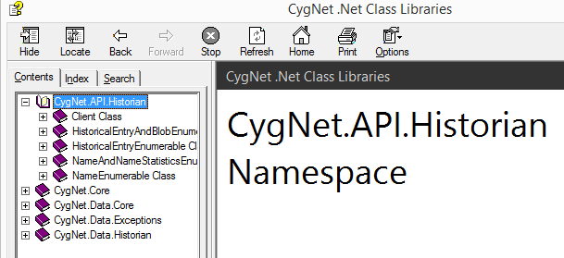
Why Develop Solutions in .NET?
…because we are at CygNet!
New CygNet API is focused primarily on
.NET consumption
  8.1.3 CygNet.API.Historian
  8.2.0 CygNet.API.[TBD] ☺
Notes:
We’re eating our own dog food. Practicing what we preach.
CygBOB
Enterprise Gateway
Cerberus, RRL, Mobile App, IRIS
Applied Engineering – CygNet Designer
Internal tools and Unit Testing

Slide 6
…But VBScript Still Has Its Place
Hammer vs. nail gun vs. wood glue
Legacy solution maintenance
  Screens, reports, batch processes, etc.
New “simple” solutions
Notes:
Programming languages are tools. Not a religion. We aren’t trying to “convert” you to .NET.
We aren’t saying “Throw out your hammers, ‘cause you should now use a nail gun for everything”

Slide 7
Demo: Porting VbScript to VB.NET
HSS “Calc Delta” Script example from CygNet Help
  Scripting >
  CygNet Scripting Guide >
  HyperPoint Scripting >
  HyperPoint Scripting Examples
Notes:
DS

Slide 8
Demo: porting VbScript to VB.NET
Create a VB.NET class library project
Copy/paste your VBScript code into a new VB.NET class
Compile. Fix any compilation errors such as:
  References to CygNet global functions or the point object by creating your own objects.
  Some functions do not translate (i.e. IsObject)
Optional: make improvements
  Variables and subroutine parameters may be explicitly typed
  Refactor to take advantage of try/catch exception handling. No more need for “On Error Resume Next”!
Notes:
DS

Slide 9
Demo: porting VbScript to VB.NET
Takeaway:
  Porting legacy VBScript code to VB.NET is straight forward
Notes:
DS

Slide 10
Powershell Tips
Intellisense
  File path completion (c:\...)
  Registry keys (Dir hklm:\...)
  Function names and parameters
  Variables
  Command History (# followed by Ctrl+Space)

Slide 11
Powershell Tips
All DOS commands work
Can run a remote console against a different computer on the network
Can schedule jobs on remote computers
Easy access to help (Get-Help <Command>)
Easily read a file ($x = Get-Content c:\File.txt)

Slide 12
Demo: CygNet Software and PowerShell
Notes:
MB

Slide 13
Demo: CygNet Call Center
Notes:
MB

Slide 14
Deploying Your APP
Use CygNet version management!
  Why?
    Access control
    Version management
    Ease of deployment to your user base

Slide 15
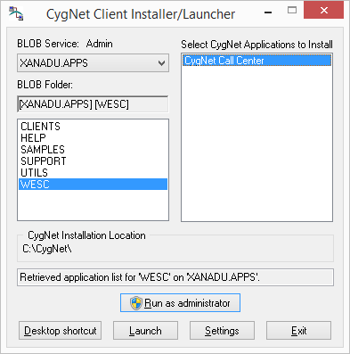
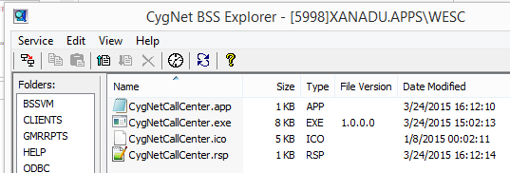
Demo: Deploying the Call Center demo
Notes:
Show off an app that doesn’t really do anything but look .NET-y, but it installs itself via version mgmt.

Slide 16
Questions?

Slide 17

For more information visit:
www.cygnetblog.com

Slide 18
Event Survey and Prizes
Online survey
  QR code or go to http://ep-weatherford.com/events/2015_WESC/WESC_Survey.html
  2 laptops in registration area
Hardcopies
  Registration desk
  Please stop by the registration desk to get your ticket for the drawing
  once you have completed the survey
Survey prizes will be drawn at the end of Wednesday in the Session Close!
You must be present to win
Notes:
Speaker to remind the audience their feedback is important and to complete and submit the surveys. Two options: either online, QR codes available on signage and at the registration desk. Or pick up a hard copy and complete, turn in to WFT staff at registration desk and pickup a ticket for the drawing. Prize drawn at EOD Wednesday during closing session, must be present to win.

