Slide 1
CygNet Database Service
Diagnostics and Performance Tuning
Rick Stember and Dan Snyder

Slide 2
Agenda
In this session we’re going to talk about:
  CygNet Database Services (DBS)
  Common functionality
  DBS Server-side caching
  Client-side diagnostics/tuning
  Indexes

Slide 3
DBS 101 – What’s a DBS?
Built on Microsoft Extensible Storage Engine (ESE)
  ESE is used with Microsoft Exchange and can support databases up to 16 TB
Database Services:
  ACS, BSS, AUD, DDS, ELS, FAC, GNS, GRP, NOTE, PNT, TRS
VHS: not a DBS, but built on ESE

Slide 4
DBS Common Functionality
ESE goodness
  Caching, logging, utilities, ACID reliability
DDL (Database Definition Language)
  Defines records, fields, indexes
Common messages, info items, utilities
“DBS-based” service

Slide 5
ESE Caching
This is the number 1 takeaway of this talk!
What is a cache?
  Main idea:
    Physical memory access > Disk I/O
    When fetching data from the disk, why not read extra data (“page”) so that the next read is more efficient?
  The ESE cache will store recently used pages in memory in anticipation of future access
  Caching especially helps with sequential access

Slide 6
Caching (Continued…)
64-bit services > 4GB per process
Strawpoll
  Production CygNet host w/ least physical memory
  Production CygNet host w/ most physical memory
Notes:
Anecdote: We know of a customer that has access to a machine with 1TB of physical mem

Slide 7
Cache Tuning
How do you determine the minimum and maximum sizes?
  Art, not a science
  Requires physical memory
  Bigger is usually better
  Direct correlation between DB size and cache requirements
All services are not of equal importance
  Cache settings are configured per service

Slide 8
When to Increase your Cache
When would you want to increase your cache usage?
  When your database size has increased
  When you need faster read/write rates
    Symptoms: Nav Bar is taking too long to load, etc.
Don’t blindly increase cache sizes on all services!
  Competition
  Prioritize
Notes:
Often databases grow slowly, but over time they may change significantly.
“Important”

Slide 9
Distributing Cache Example
Service
ACS
AUD
BSS/APPS
DDS
ELS/ELSALM
FAC
GRP
PNT
TRS
VHS
How should we distribute 20 GB of physical memory between these services?
  Evenly = 2 GB per service (WRONG)
  Note: 20 GB is not much. This is just an example.

Slide 10

Distributing Cache Example
Service | DB+Inx Size (GB)
VHS | 150
ELS/ELSALM | 50
AUD | 50
DDS | 20
PNT | 2
BSS/APPS | 2
GRP | 1
FAC | .2
ACS | .01
TRS | .01
First, order by
Database size + Index size
Service Diags:

Slide 11
Distributing Cache Example
Service | Perf. Criticality
VHS | HIGH
ELS/ELSALM | Medium
AUD | Medium
DDS | HIGH
PNT | HIGH
BSS/APPS | Low
GRP | HIGH
FAC | HIGH
ACS | Low
TRS | Low
Second, determine “performance criticality”
  Message rate
  Screen dependencies (Grids, Trends)
  Polling (DDS)

Slide 12
Distributing Cache Example
Service | DB+Inx Size (GB) | Min Cache (GB) | Max Cache (GB) | Perf. Criticality
VHS | 150 | 10 | 20 | HIGH
ELS/ELSALM | 50 | 1 | 2 | Medium
AUD | 50 | 1 | 2 | Medium
DDS | 20 | 3 | 4 | HIGH
PNT | 2 | 2 | 4 | HIGH
BSS/APPS | 2 | 0 | 2 | Low
GRP | 1 | 1 | 2 | HIGH
FAC | .2 | .2 | 1 | HIGH
ACS | .01 | 0 | .1 | Low
TRS | .01 | 0 | .1 | Low
Notes:
Focus on the MIN cache setting.
ESE is aggressive in allocating up to the MIN amount
Monitor cache “active” and re-balance as necessary.

Slide 13
How to Increase Your Cache
Config file keywords:
  DBS_DISK_CACHE_IN_MEGS
  DBS_MIN_DISK_CACHE_IN_MEGS
Notes:
The MIN keyword is relatively new and is key

Slide 14
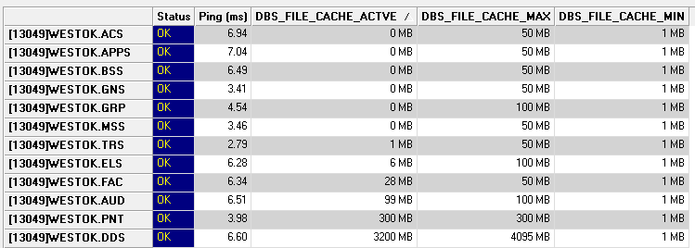
Monitoring Cache Usage
Info items
  DBS_FILE_CACHE_ACTIVE, MAX, MIN
Notes:
ServiceMon-able info items
Service Details Dialog
Service Daigs

Slide 15
Demo: Point Report

Slide 16
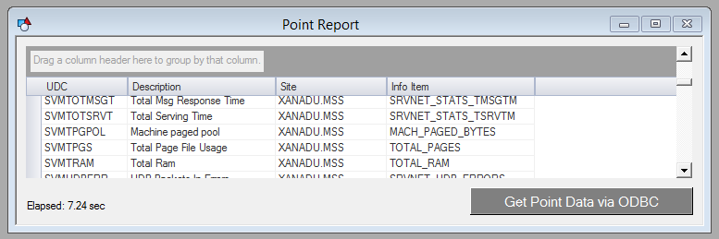
Diagnostics / Tuning: Point Report v1
Select * from WESCAPI_PNT.pnt_header_record
Full table scan
GET_TABLE_ROW
~50 points per message

Slide 17
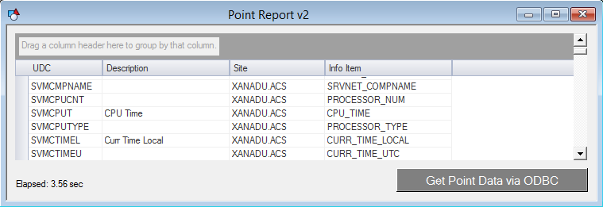
Diagnostics / Tuning: Point Report v2
Select just the columns that you need
Still a full table scan…
DBS_GET_VIEW
~500 points per message

Slide 18
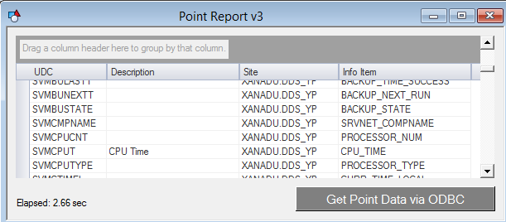
Diagnostics / Tuning: Point Report v3
Qualify the points (where clause)
No longer a full table scan!
DBS_GET_VIEW_BY_INDEX_LIST
~300 points per message

Slide 19
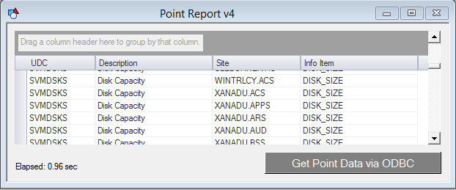
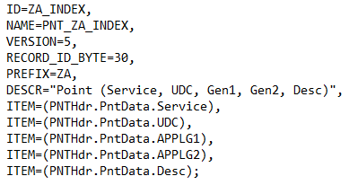
Diagnostics / Tuning: Point Report v4
Add custom index to the PNT (PntAppl.ddl)
DBS_GET_VIEW_BY_INDEX_LIST
PNT only needs to scan the index

Slide 20
Custom Indexes (Continued…)
Why would you want a custom index?
  Performance!
Why not add indexes for EVERYTHING?
  Index database size
  Writes become less efficient
Notes:
If I have 100 indexes that include Attribute X, when I update the attribute, 100 indexes need to be updated

Slide 21
Custom Indexes (Continued…)
How do you configure them?
  Modify Appl.ddl
  Stop service
  Run ReindexESE
  Start service

Slide 22
Don’t excessively update your DBS data
FAC and PNT records should not be updated frequently
Client-side cache effectiveness

Slide 23
Recap
DBS Common functionality
DBS Server-side caching
Client-side diagnostics/tuning
Indexes

Slide 24
Questions?

Slide 25

For more information visit:
www.cygnetblog.com

Slide 26
Event Survey and Prizes
Online survey
  QR code or go to http://ep-weatherford.com/events/2015_WESC/WESC_Survey.html
  2 laptops in registration area
Hardcopies
  Registration desk
  Please stop by the registration desk to get your ticket for the drawing
  once you have completed the survey
Survey prizes will be drawn at the end of Wednesday in the Session Close!
You must be present to win
Notes:
Speaker to remind the audience their feedback is important and to complete and submit the surveys. Two options: either online, QR codes available on signage and at the registration desk. Or pick up a hard copy and complete, turn in to WFT staff at registration desk and pickup a ticket for the drawing. Prize drawn at EOD Wednesday during closing session, must be present to win.

