Slide 1
Device Template File (DTF) Authoring
Ryan Ackerman, Software Developer

Slide 2
Overview
What’s a DTF file all about?
How do I use conversion functions?
How do I use reference methods?
How do I know my edits are valid?

Slide 3
Device Template
What is a template
Design considerations
Similarities between EIEs
Common Attributes
Matching device data

Slide 4
What is a template?
XML Document
Represents
  Device Data Configuration
  Logical/Normalized Representation of Data
Identifies the type of device in CygNet
Read/Write Access
Notes:
Device Data Configuration:
Blocks
Logical Representation
Deids

Slide 5
Design Considerations
Do I duplicate data?
Is there an advantage to using small data groups?
Are there considerations when executing from a UIS command?
Can I mix and match data from different data groups?

Slide 6
Similarities between EIEs
General properties
  Device type
  EIE type
Data groups
Data elements
<deviceDefinition deviceType="WESC - SLC" eieType="AllenBradleyCIP" >
<dataGroups …
<float1 type="r4"/>
Notes:
Data Groups
Property inheritance (child parent)

Slide 7
Common Attributes
type=“”
  Device
  CygNet/DDS
byteOrder=“”
cvtF=“”
readOnly=“”
ref=“” isRef=“”

Slide 8
Matching Device Data
What is this value? 00 00 80 3F
CrcGenerator, Comm data (advanced details)
Data Type / Byte Order | Value
r4 (IEEE 754) / Little Endian | 1
ui4 / Big Endian | 32831
ui2 / Big Endian | 0
ui4 / Big Endian / Word Swap | 16256

Slide 9
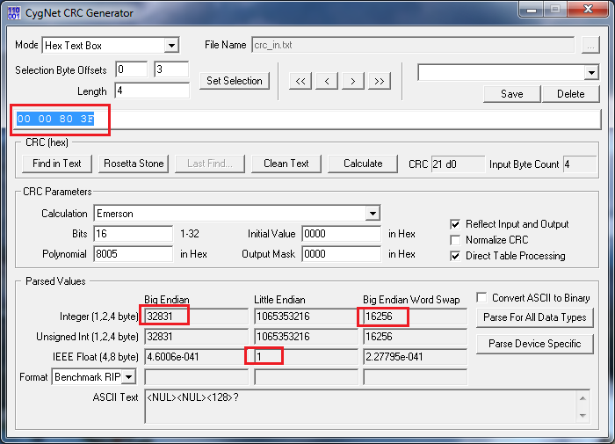
CRC Generator

Slide 10
Conversion Functions (cvtF)
What purpose do they serve?
Example

Slide 11
What purpose do they serve?
Additional normalization
Writable
Brevity
Raw source not retained
Notes:
Why?
More complex typing

Slide 12
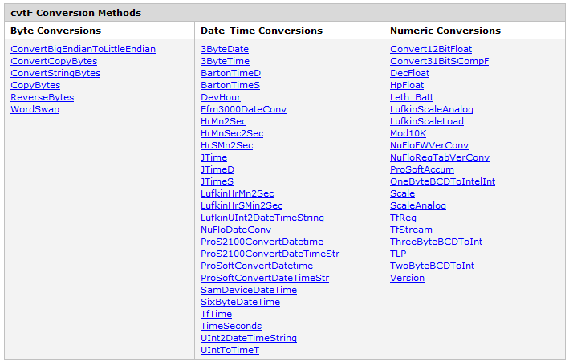
Available Conversion Functions

Slide 13
Example
More complex conversion required
Brevity
<CRtmCr desc="Runtime current cycle" cvtF="3ByteTime" type="ui4" units="sec"/>
Source Data | Result
01 09 07 | 4147 (seconds)
<BaseStkLen desc="Base Stroke Length"
type="r4"
cvtF="Scale"
sourceType="i2"
scaleFactor="0.1"/>
Notes:
Brevity, as compared to reference methods

Slide 14
Reference Methods
Basic method
Advanced method

Slide 15
Reference Methods (Basic)
One to one relationship
Calculated value
Time of calculation
  Display
  Point processing
Read/Write

Slide 16
Reference Methods (Advanced)
One to many relationship
Values are read only
Extremely flexible
Wide range of features and functions

Slide 17
Template validation
DTF Manager
Loading templates
Displaying an editor
Loading device driver

Slide 18
Build Modbus Template (Demo)
Analyze device specification
DtfMgr
Define data groups
  Analog input
  Meter configuration (ordinal)
  Status
  Gas history
  RTU configuration
  Composite data group
Poll the device

Slide 19

For more information visit:
www.cygnetblog.com

Slide 20
Event Survey and Prizes
Online survey
  QR code or go to http://ep-weatherford.com/events/2015_WESC/WESC_Survey.html
  2 laptops in registration area
Hardcopies
  Registration desk
  Please stop by the registration desk to get your ticket for the drawing
  once you have completed the survey
Survey prizes will be drawn at the end of Wednesday in the Session Close!
You must be present to win
Notes:
Speaker to remind the audience their feedback is important and to complete and submit the surveys. Two options: either online, QR codes available on signage and at the registration desk. Or pick up a hard copy and complete, turn in to WFT staff at registration desk and pickup a ticket for the drawing. Prize drawn at EOD Wednesday during closing session, must be present to win.

