Slide 1
Optimizing Device Communication and Analyzing UIS Performance
Ryan Ackerman, Software Developer
Notes:
Notes……
Who am I! Ryan Ackerman, Software Developer. I may have talked to you during support phone calls.
7 Days ago, I wake up to one after another of people vomiting in my house, until everyone except for me is sick.
Which gives me the opportunity to think with a semi clear mind. For the time of day.
How would I felt over 300 years ago….
While I am not an expert performance analyzer, I do have a microscopic insight into the way that the cygnet polling engine works.

Slide 2
Overview: UIS Performance
How does UIS processing work?
  How do I optimize device communications?
How can I create an optimal polling strategy?
How do I monitor UIS performance?
Notes:
Going to go into detail for each section, how to optimize, before moving onto the next section

Slide 3
Processing Device Data
Remote Message Object
  One or more related objects that represent work to be done
Creation
  MSS
  Editors
  Script
Comm Processing
Response Processing

Slide 4
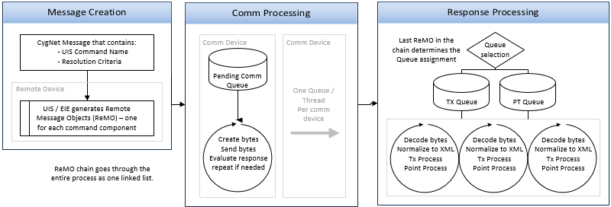
UIS Processing Flow

Slide 5
Message Creation
Sources will vary
Fail on error
Could be one or
more messages
created depending
on task complexity

Slide 6
Comm Processing
Destination after
message creation
One thread of
execution per
comm device
Data validation
only
Update statistics

Slide 7
Comm Threads
One thread of execution per comm device
Cost of a bulk poll with hundreds of comms
Using a multipoint TCP comm

Slide 8
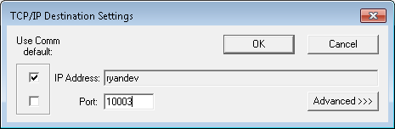
Using a Multipoint TCP Comm
Modify comm settings per remote device
Single thread of execution

Slide 9
Device Performance
Amount of Data
# of Round Trips
Latency
Total Cost of Operation
    Round Trip Time * # of Trips
  Different requirements define performance differently

Slide 10
Amount of Data
How is the data organized?
Flexibility (Don’t point that gun at your foot)
  Data request structure.
Comm infrastructure considerations?

Slide 11
No Optimization
Allen Bradley SLC
Data Transfered
  434 Bytes
  4 Round Trips
<fileBlocks> <block1 fileNum="8" fileType="F" startElem="0" numElems="3"/> <block2 fileNum="8" fileType="F" startElem="9" numElems="2"/> <block3 fileNum="8" fileType="F" startElem="25" numElems="1"/> </fileBlocks>

Slide 12
Optimization
Allen Bradley SLC
Data Transfered
  278 Bytes
  2 Round Trips
<fileBlocks> <block1 fileNum="8" fileType="F" startElem="0" numElems="26"/> </fileBlocks>

Slide 13
Applies to Other EIEs
Modbus
<modbusReadBlocks> <block1 regCnt="1" regNum="1000" regByteLen="4" funcCode="3"/> <block2 regCnt="1" regNum="1010" regByteLen="4" funcCode="3"/> <block3 regCnt="1" regNum="1020" regByteLen="4" funcCode="3"/> </modbusReadBlocks>

Slide 14
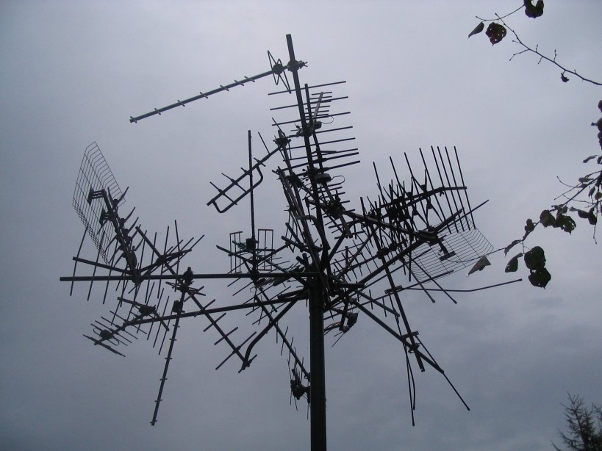
Wire Data In/Out (Analysis)
Latency
  External Causes
    Connection Type
    Environmental

Slide 15
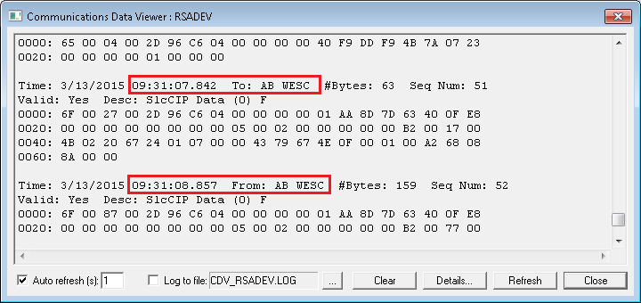
Identifying Latency (External)
Comm Data Viewer

Slide 16
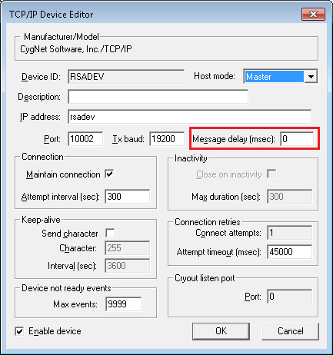
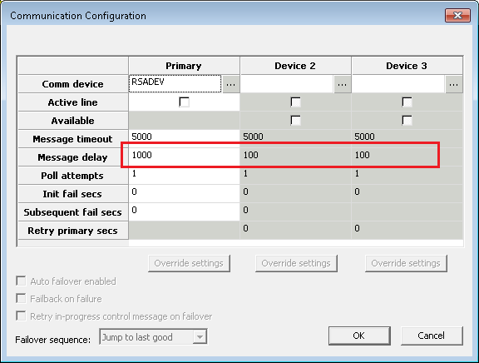
Wire Data In/Out (Analysis)
Latency
  Internal Causes
    Message Delay
      Remote
      Comm
The greater of the two values is used

Slide 17
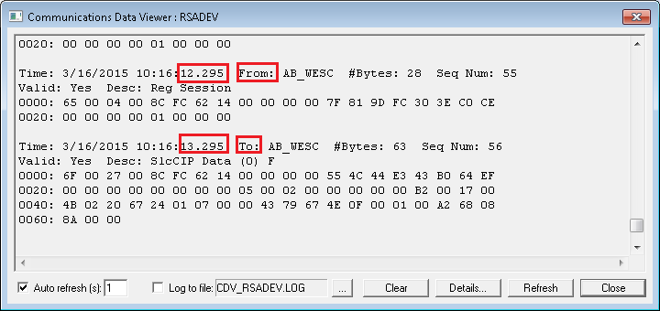
Identifying Latency (Internal)
Comm Data Viewer

Slide 18
Response Processing
TX vs. PT Queue
Three threads per queue
Normalize data to XML
Writes data to database
Updates point records

Slide 19
Response Processing
Several operations executed
  Parse response
    Decode bytes
    Do any conversions
    Normalize to XML
  Process points
    Generally fast
  Save data
    Avoid when necessary
      forceSave=“true|false”

Slide 20
TX/PT Queue Configuration
Number of threads
Positive effects of thread count
Negative effects of thread count
UIS.cfg
  TXTHREADS
  PNTTHREADS

Slide 21
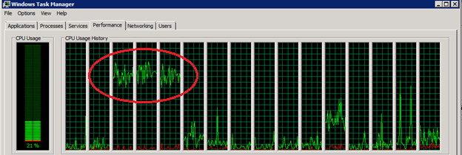
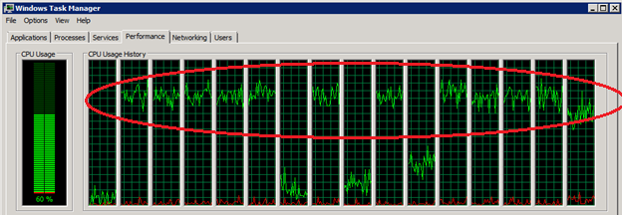
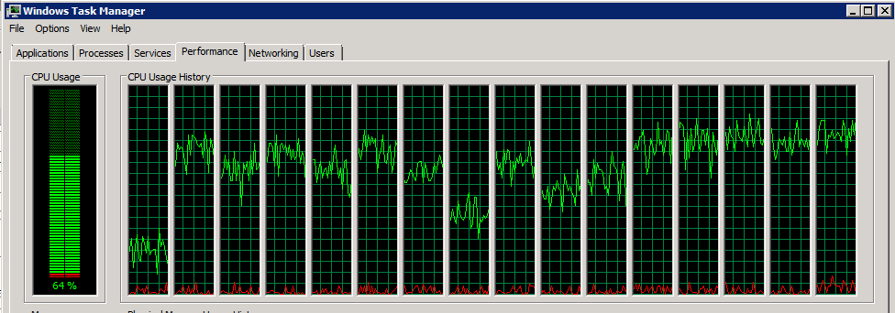
PT/TX Thread Configuration
Default
12 threads (optimized)
16 threads (degrading)

Slide 22
Evaluating DDS File Access
Is there data that is not needed?
Costs to write
Costs to prune
Moving DDS/database to fast disk (SSD)

Slide 23
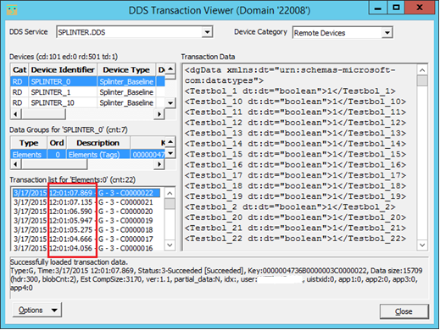
DDS Excess Transactions
How to identify

Slide 24
Polling Strategy
Schedule
Organization
Throttling

Slide 25
Polling Schedule
Frequency
Evaluate relationship between poll schedule and data
Break up polls into critical, high and low tasks

Slide 26
Organizing Polls
By data
  Real Time
  Historical
By comm (fine tuned throttling)
By frequency
By priority

Slide 27
MSS Task Throttling
Response processing queue size
Global comm queue size
Comm specific queue size

Slide 28
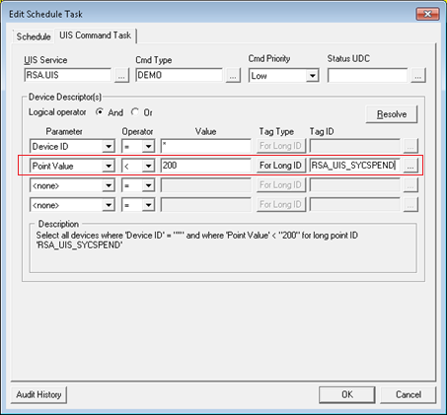
MSS Task Throttling Points
UDCs
  Pending comm <SYCSPEND>
  Response processing <SYPROCQUE>
Facilities
  UIS
  COMM
Points on UIS
  Response processing queue
  Global comm queue
  Comm specific queue

Slide 29
UIS Performance Administration
SvcMon
Trend screen

Slide 30
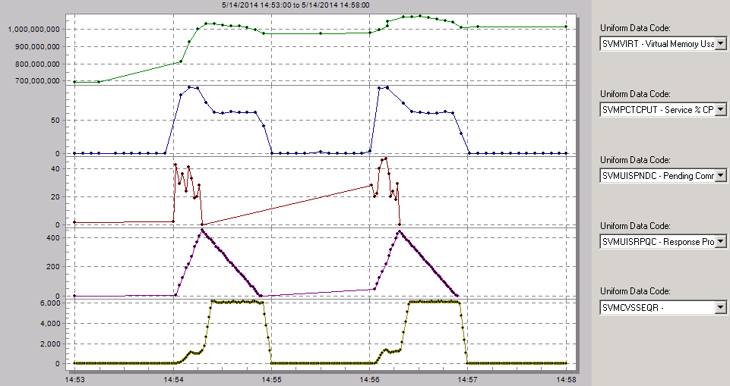
UDC Trend Screen

Slide 31
Questions

Slide 32

For more information visit:
www.cygnetblog.com

Slide 33
Event Survey and Prizes
Online survey
  QR code or go to http://ep-weatherford.com/events/2015_WESC/WESC_Survey.html
  2 laptops in registration area
Hardcopies
  Registration desk
  Please stop by the registration desk to get your ticket for the drawing
  once you have completed the survey
Survey prizes will be drawn at the end of Wednesday in the Session Close!
You must be present to win
Notes:
Speaker to remind the audience their feedback is important and to complete and submit the surveys. Two options: either online, QR codes available on signage and at the registration desk. Or pick up a hard copy and complete, turn in to WFT staff at registration desk and pickup a ticket for the drawing. Prize drawn at EOD Wednesday during closing session, must be present to win.

