Slide 1
Let’s Do Something Noteworthy:
Why You Should be Using the CygNet® Note Service
Walter Goodwater, Lead Software Engineer Corey Lee, Product Advisor

Slide 2
Why Should You Be Using Notes?
Because it has great features
Using the Trend control and Note Feed
Because you can do cool and practical things
Using notes to report and track issues from the field
Using notes to record and categorize downtimes
Because all the cool kids are doing it
Discussion: are you using notes? Any ideas how you might?

Slide 3
Note Features
Introduced in 8.1.0 as core product
Standard CygNet Service features
Scalability
Replication
Security
Custom database indexing
Notes:
Ask if any customers are using Notes

Slide 4
Note Features
Unlimited note text length
Notes can be associated with Points and/or Facilities
Note service reference as many Current Value services as you wish
Note duration
Point-in-time
Time range

Slide 5
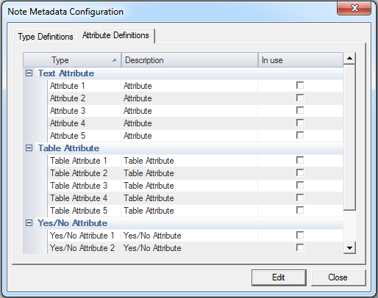
Note Features
Configurable note types
Notes can be “Issues” or “Downtimes” or “Secret Santa assignments”
Custom Note Attributes:
5 text attributes
5 table-driven attributes
5 yes/no attributes

Slide 6
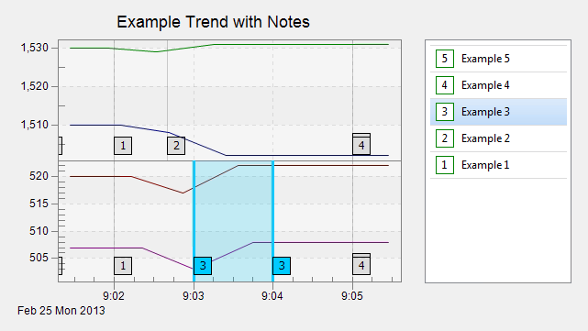
Note Features
Data available via standard CygNet API options:
CxNote: easy to use
ODBC: powerful
Studio Control Integration
Note Feed control
Trend control

Slide 7
Note Demos
Using notes with the Trend and Note Feed controls
Using notes to report and track issues from the field
Using notes to record and categorize Downtimes

Slide 8
For more information visit:
www.cygnetblog.com

Slide 9
Event Survey and Prizes
Online survey
QR code or go to http://ep-weatherford.com/events/2015_WESC/WESC_Survey.html
2 laptops in registration area
Hardcopies
Registration desk
Please stop by the registration desk to get your ticket for the drawing once you have completed the survey
Survey prizes will be drawn at the end of Wednesday in the Session Close!
You must be present to win
Notes:
Speaker to remind the audience their feedback is important and to complete and submit the surveys. Two options: either online, QR codes available on signage and at the registration desk. Or pick up a hard copy and complete, turn in to WFT staff at registration desk and pickup a ticket for the drawing. Prize drawn at EOD Wednesday during closing session, must be present to win.

